Slide 1



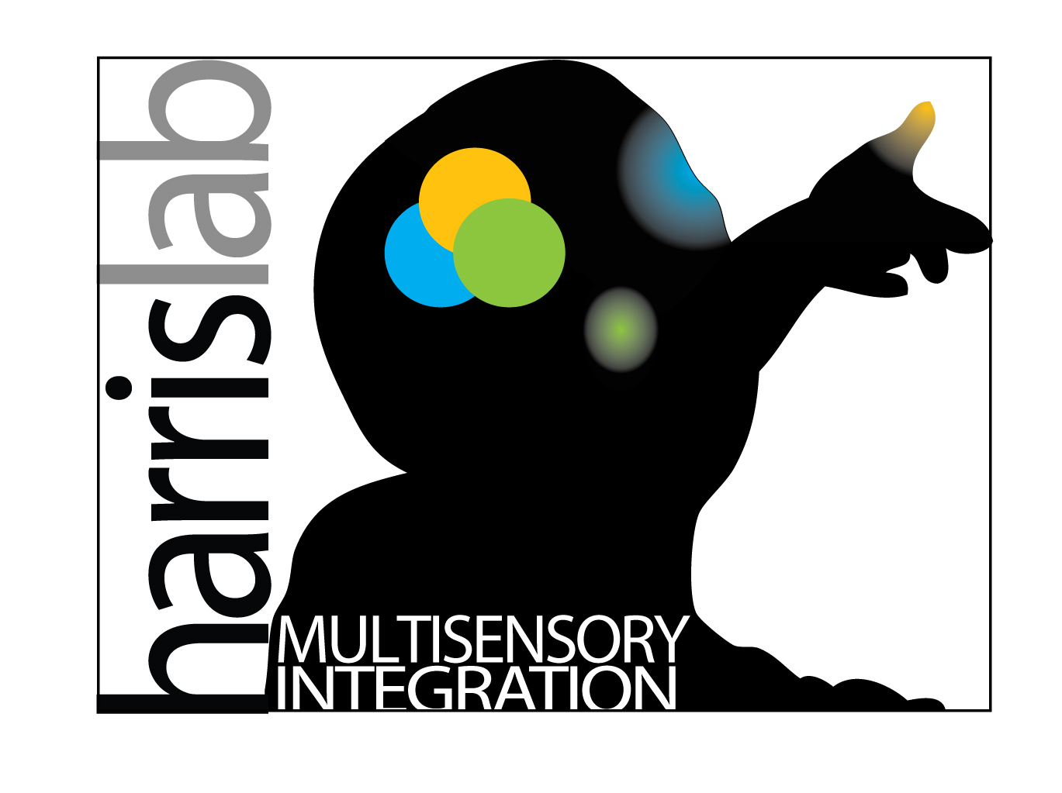

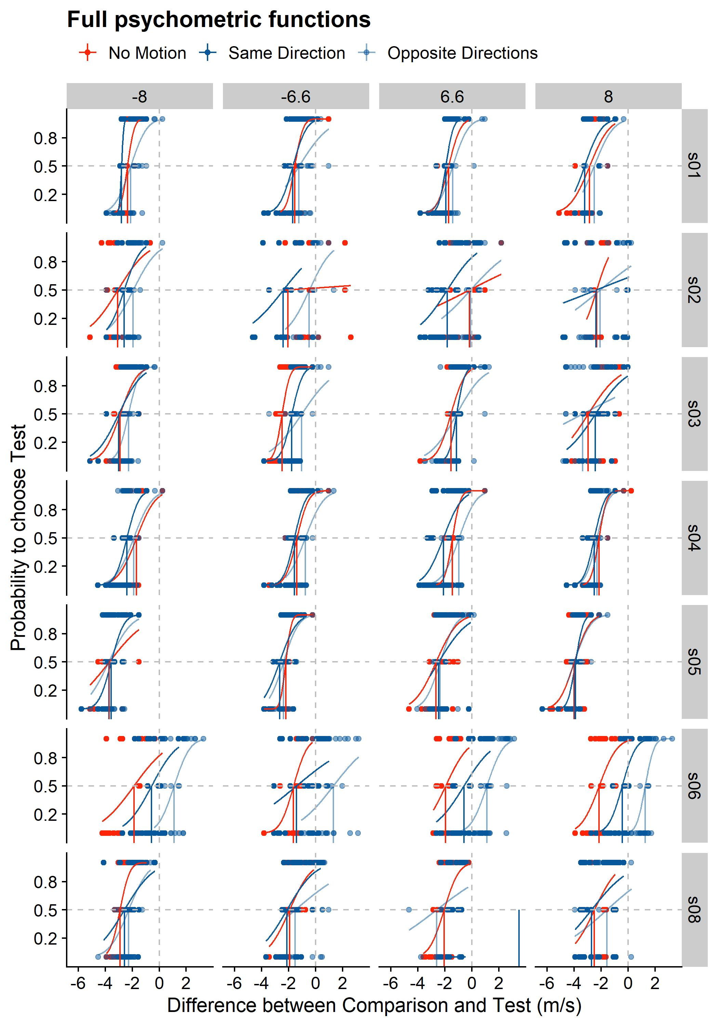
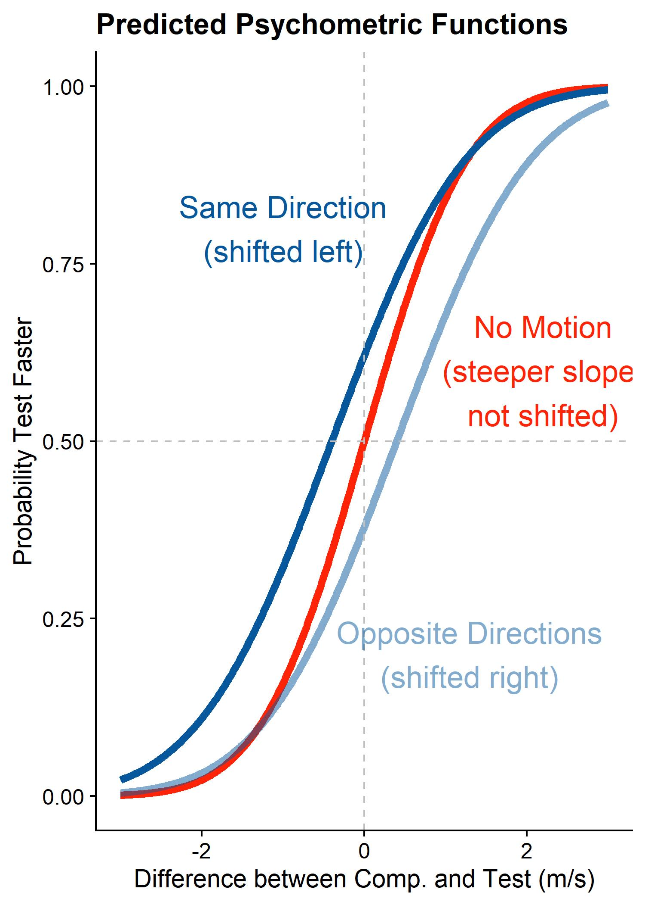
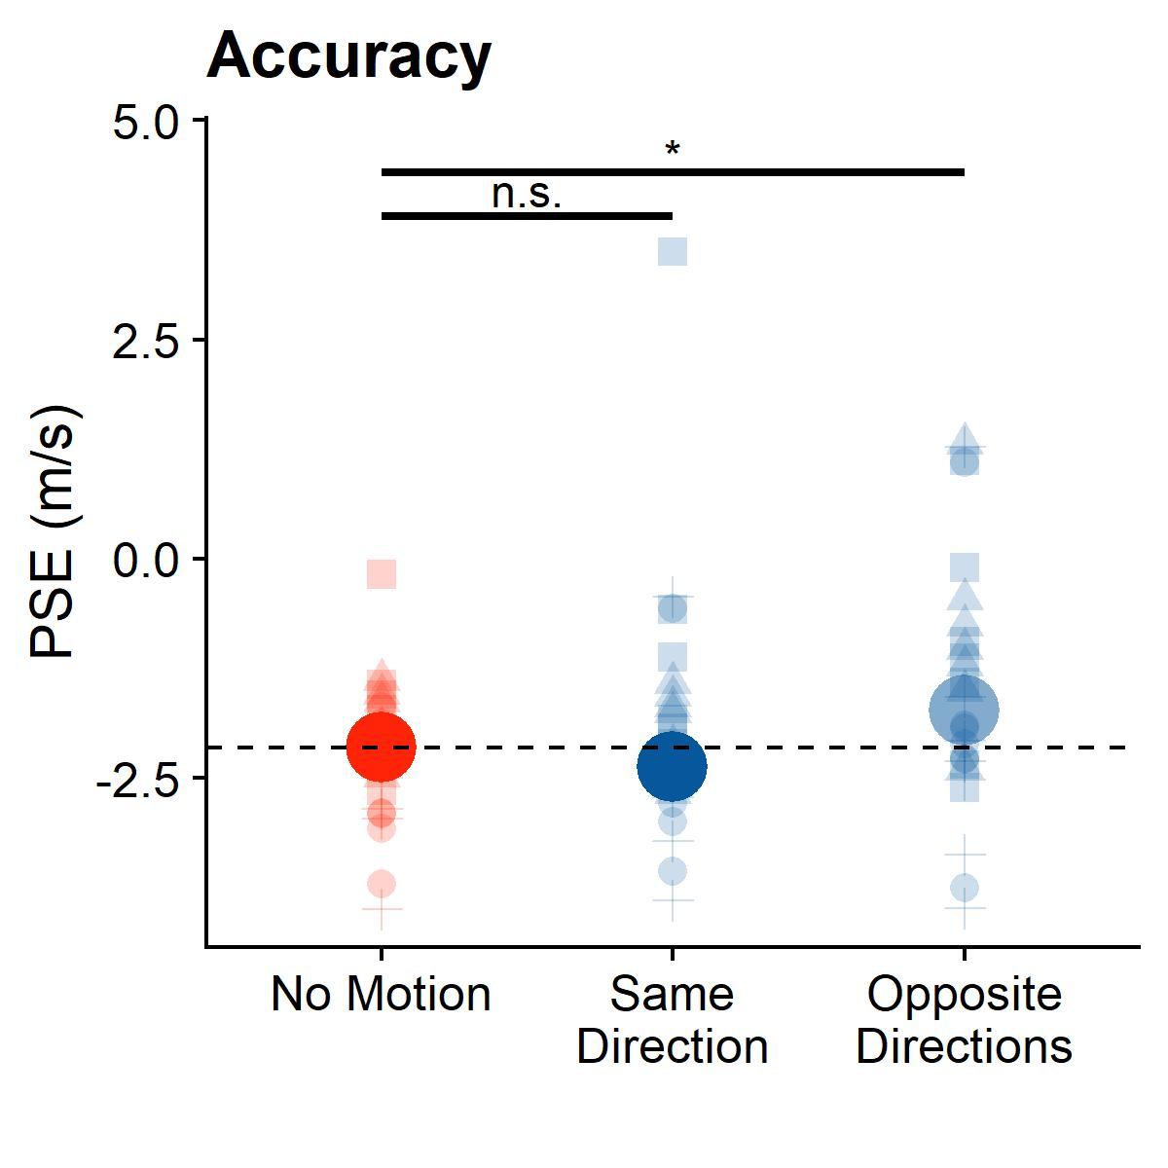
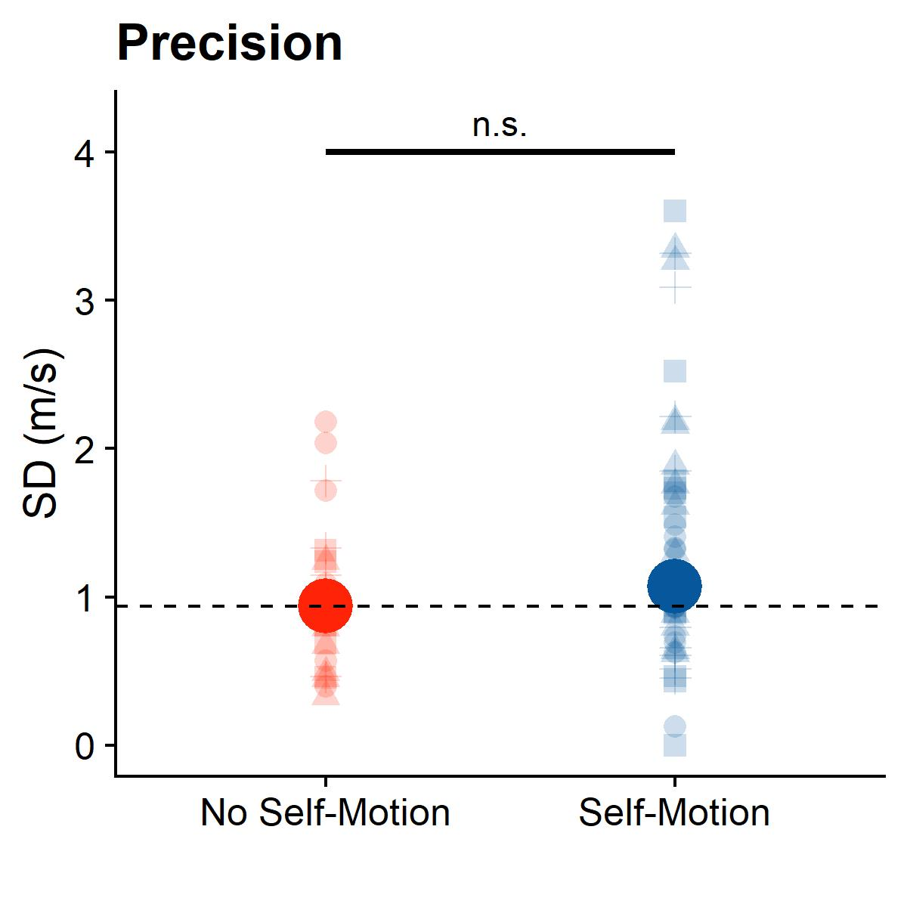
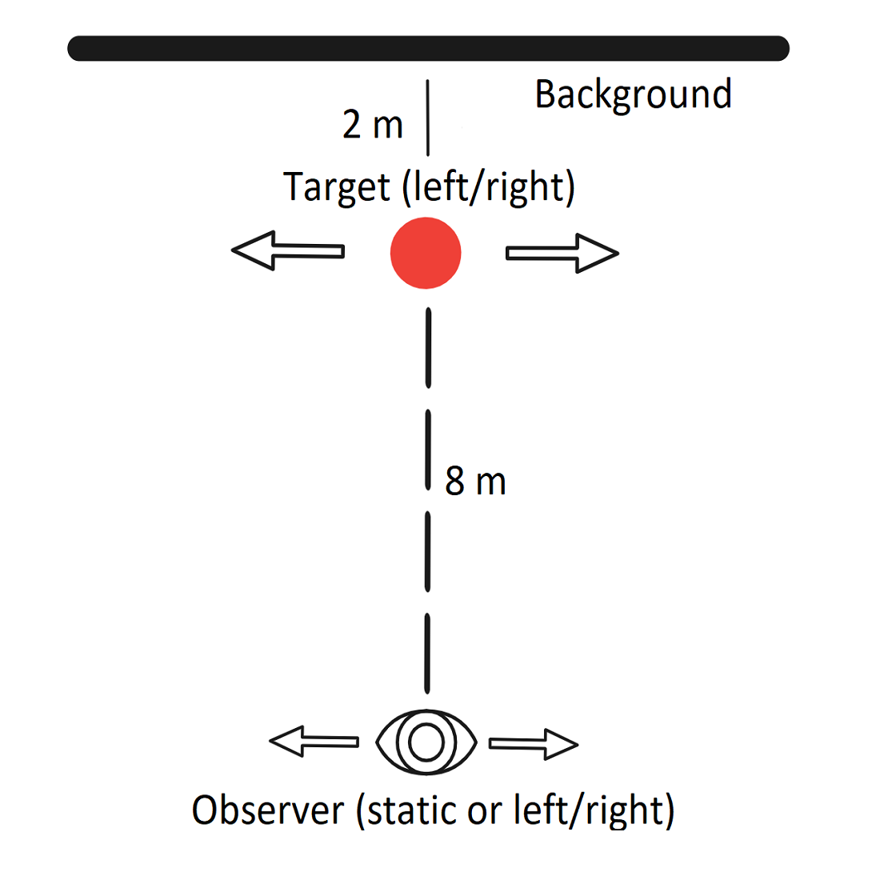
Incomplete Compensation for Self-Motion in the Visual Perception of Object Velocity during a Visual-Vestibular Conflict
Björn Jörges, Laurence Harris
Center for Vision Research, York University
VISTA
bjoerges@yorku.ca
Twitter: @b_jorges
Background & Objective
Results
Retinal motion elicited by an object is ambiguous and can be due to:
object-Motion
self-Motion
Estimating self-motion is a multisensory process:
vestibular
visual
efference copies
Can we compensate fully for self-motion in the absence of efference copies and vestibular cues? Does compensation come at a precision cost?
Hypotheses:
self-motion and object motion in the same direction in absence of vestibular cues /efference cues lead to a lacking compensation, i.e., an underestimation of target velocity and vice-versa
curve shifted left or right
Self-Motion leads to noisier judgments
Shallower curve
Figure 3: Psychometric functions per participant (rows of panels) and standard velocity (columns of panels); negative velocities correspond to leftwards object motion
Figure 1: Predicted psychometric functions
Methods
The task: Which of two presented motions is faster?
A SAME DIRECTION TRIAL
AN OPPOSITE DIRECTION TRIAL
motion from self-motion
motion from self-motion
motion from object-motion
motion from object-motion
self motion
self motion
Figure 4: Big solid dots – median PSEs/SDs across participants and standard velocities. Translucent dots – PSEs/SDs per participant and standard velocity. Dashed lines – median value for stationary observer.
Figure 2a: Participant view – target
Figure 2b: Participant view – target
Ball cloud perceived as much faster than single target
On average, incongruent motion is judged as too fast (p < 0.05) and congruent motion judged roughly as accurately as no motion (p = 0.8)
On average, subjects judge speed somewhat less precisely when self-motion is simulated (p = 0.09)
The stimuli
Two motion intervals presented at eye-height in 3D virtual environment
One big target (6.6 or 8 m/s left or right; Fig. 2a/2b), one ball cloud (velocity PEST staircase-controlled)
Conclusions
Compensation for self-motion is nearly complete, even in the absence of efference copy & vestibular cues, at the cost of a marginally lower precision
Figure 2c: top view of stimulus
Participant moved visually in the same or opposite direction as the target, or static during observation of big target; no physical motion
GIF of stimulus available here (GitHub)
Dependent variables: Mean (accuracy) and slope (precision) of psychometric function
Open Science & References
All resources are available under https://github.com/b-jorges/Motion-Perception-during-Self-Motion/.
[1] Dokka, K., MacNeilage, P. R., DeAngelis, G. C., & Angelaki, D. E. (2015). Multisensory self-motion compensation during object trajectory judgments. Cerebral Cortex, 25(3), 619–630. https://doi.org/10.1093/cercor/bht247
[2] Dupin, L., & Wexler, M. (2013). Motion perception by a moving observer in a threedimensional environment. Journal of Vision, 13(2), 1–14. https://doi.org/10.1167/13.2.15

